Slide 1
SQL Server
Normalization
In all slides, db=database

Slide 2
Database Design
We have learned the how when it comes to table creation, now we are going to delve into why we break up data into specific tables and what are the “best practices” to consider when designing a database

Slide 3
Table – A Review
A table
  Collection of real-world data
  Considered an “entity”
  Data is divided into rows and columns
Tables are related to each other
Related tables are grouped together in a common database

Slide 4
What is Normalization?
Normalization is the process of designing database tables to ensure that the fields in each table do not repeat, are fully identified by a unique KEY, and are not dependent on any non-key ATTRIBUTEs.
As part of the normalization process, large tables are often broken up into smaller tables with defined relationships that associate them.

Slide 5
Why Normalize?
Isolates data so that additions, deletions, and updates to a field of data can be made in just one table
Reduces redundancy of the data and represents the data in a clear and organized fashion.

Slide 6
Example Problem
Generic Example:
Consider an a customer can have multiple orders and an order can include multiple products.
0NF (No normalization)
ORDERS(OrderNo, OrderDate, CustomerNo, CustomerName, CustomerAddress, ItemsOrdered)

Slide 7
Example Problem (cont’d)
OrderNo | OrderDate | CustomerNo | CustomerName | CustomerAddress | ItemsOrdered
100 | 1/1/99 | 54545 | ACME Co | 1234 1st St. | 1-A4535, Flange, 7lbs, $75 4-OR2400, Injector, .5lbs, $108 4-OR2403, Injector, .5lbs, $116
101 | 1/1/99 | 12000 | Sneed Corp. | 555 Main Ave. | 1-3X9567, Pump, 5lbs, $62.50
102 | 1/1/99 | 66651 | ZZZ & Co. | 4242 SW 2nd | 7-8G9200, Fan, 3lbs, $84 1-8G5437, Fan, 3lbs, $15

Slide 8
The First Normal Form
The first normal form (1NF) is all about eliminating repeating groups of data and guaranteeing atomicity(the data is self-contained and independent).
At a high level, it works by creating a primary key then moving any repeating data groups into new tables, creating new keys for those tables, and so on.
In addition, we break out any columns that combine data into separate rows for each piece of data.

Slide 9
The First Normal Form - Example
1NF
We can start by moving some columns out of the table and into their own table to get rid of repeating data
CUSTOMERS (CustomerNo, CustomerName, CustomerAddress)
ORDERS (OrderNo, OrderDate, CustomerNo, ItemsOrdered)

Slide 10
The First Normal Form (cont’d)
We have eliminated repeating groups of data
1NF is also about ensuring atomicity (data is self-contained and independent)
ItemsOrdered column contains several pieces of data that need broken into separate pieces
  Part number, part weight, part price

Slide 11
The First Normal Form (cont’d)
ORDERS(OrderNo, LineItem, OrderDate, CustomerNo, PartNo, Description, Qty, UnitPrice, TotalPrice, Wt)
Note that LineItem was introduced as a new column and is used as part of a composite primary key
We have now eliminated repeating groups and achieved atomicity, so we have First Normal Form (1N)

Slide 12
The Second Normal Form
The next phase in normalization is to go to the second normal form (2NF).
Second normal form further reduces the incidence of repeated data (not necessarily groups).
Second normal form has two rules to it:
  The table must meet the rules for first normal form. (Normalization is a building block kind of process—you can’t stack the third block on if you don’t have the first two there already.)
  Each column must depend on the whole key.

Slide 13
Second Normal Form (cont’d)
Note that OrderDate and CustomerNo repeat for every row of a specific order. That means that they are only dependent upon OrderNo and not OrderNo and LineItem. In other words, they are not dependent upon the whole primary key
This means that we need to break this table into 2 tables
  Header table
  Detail table

Slide 14
Header and Detail Tables
Header
  Contains information that needs stored once
  Usually keeps the name of the original table
Detail
  Contains information that may exist in multiple instances
  Can have many detail records for a single header record
  Usually has a name that starts with the header name and adds something on the end to indicate that it is a detail table

Slide 15
The Second Normal Form - Example
2NF - remove partial dependencies
ORDER(OrderNo, OrderDate, CustomerNo)
ORDERDETAILS(OrderNo, LineItem, PartNo, Description, Qty, UnitPrice, TotalPrice, Wt)
CUSTOMER(CustomerNo, CustomerName,
CustomerAddress)

Slide 16
The Third Normal Form
Third normal form deals with the issue of having all the columns in our table not just be dependent on something—but the right thing.
Third normal form has three rules:
  The table must be in 2NF (building blocks).
  No column can have any dependency on any other non-key column.
  You cannot have derived data.

Slide 17
Third Normal Form (cont’d)
OrderNo | LineItem | PartNo | Description | Qty | UnitPrice | TotalPrice | Wt
100 | 1 | 1A4536 | Flange | 5 | 15 | 75 | 5
100 | 2 | OR2400 | Injector | 4 | 27 | 108 | .5
100 | 3 | OR2403 | Injector | 4 | 29 | 116 | .5
Note that columns Description and Wt are dependent upon PartNo (and not primary key)
We need a new table to hold our “Products” information

Slide 18
The Third Normal Form (cont’d)
Note also that Total Price can be calculated by taking the Qty * UnitPrice
TotalPrice is a derived column
3NF indicates that we cannot have derived columns, so we drop that column from the table

Slide 19
The Third Normal Form - Example
3NF
PRODUCT (PartNo, Description, Wt)
ORDER(OrderNo, OrderDate, CustomerNo)
ORDERDETAILS(OrderNo, LineItem, PartNo, Qty, UnitPrice)
CUSTOMER(CustomerNo, CustomerName, CustomerAddress)

Slide 20
Relationships
There are three different kinds of major relationships:
  One-to-one
  One-to-many
  Many-to-many
Note that each of these has variations
  Example: instead of a one-to-one, you might have a zero OR one-to-one relationship

Slide 21
Relationships cont.
Each relationship will have a Primary (parent) table and a Related (child) table as previously described.
An easy way to determine the Primary table in the relationship is to note the Primary key.
Typically the Primary table is the table that holds the Primary key field in the relationship.

Slide 22
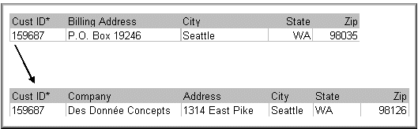
One-to-One
A one-to-one relationship means that you have a record in one table and you have exactly one matching record in another table.
In the above, you wouldn't want to assign the Customer ID to more than one customer; therefore, the Primary Key field would be Cust ID.

Slide 23
One-to-One
Note both tables have the same PK
One-to-one exists in a few scenarios
  Scenario 1: Imagine that a company has several subsidiaries. Each subsidiary has its own Customers table. However, there is also a ‘master’ table that contains customers from all subsidiaries.
  Often the result of business rules
Scenario 2: Large tables that would exceed the max size allowed by SQL Server are divided up

Slide 24
One-to-One
No inherent method exists to enforce a one-to-one relationship in SQL Server
Why? This is a “chicken and egg” scenario. If we create a FK in table1 pointing to table2 and a FK in table2 pointing to table1, how would we ever insert data?

Slide 25
Zero-to-One
A variation of the One-to-one relationship
Here, the fact that you have a record in the “one” table, doesn’t necessarily mean that you have any instances of matching records in the referencing table.
Same as a one-to-one but one side of the relationship has the option of either having a row or not

Slide 26
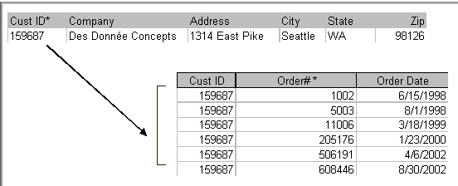
One-to-Many
One-to-Many
  The usual kind of relationship that is defined between two tables
Note that this is the Header/Detail relationship that we described earlier with the ORDER (one) and ORDERDETAIL (many) tables
Another example of one-to-many using Customer and CustomerOrders

Slide 27
One-to-Zero, One-to-One, One-to-Many
This is a One-to-Many where the referencing field (the one in the table that has a foreign key constraint) is allowed to be null
The fact that you have a record in the “one” table doesn’t necessarily mean that you have any instances of matching records in the referencing table

Slide 28
Many-to-Many
In this type of relationship, both sides of the relationship may have several records—not just one—that match.
An example of this would be the relationship of products to orders. A given order may have many different products in the order.
Likewise, any given product may be ordered many times.

Slide 29
Many-to-Many cont.
Many-to-Many usually means you are dealing with complex data.
For example, one student may have many supervisors, but equally, one supervisor will have many students.
This poses a problem in terms of how to represent the relationship without resorting to repeating attributes like this:

Slide 30
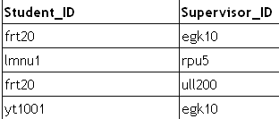
Many-to-Many cont.
The solution is to provide a third linking table, one which simply lists pairs of supervisors and supervisees.
In relational databases, many-to-many relationships always require a third linking table between the two entities which are linked by this kind of relationship.

Slide 31
Diagramming
Entity Relationship Diagrams (ERDs) are an important tool in good database design – especially for large databases.

Slide 32
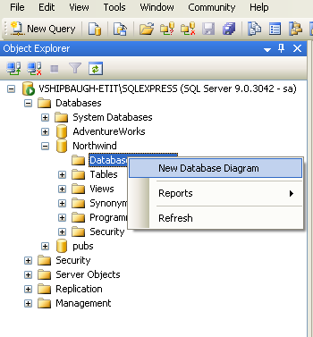
Creating a new diagram
Right-click the Diagrams node underneath the Northwind database and choose the New Database Diagram option.

Slide 33
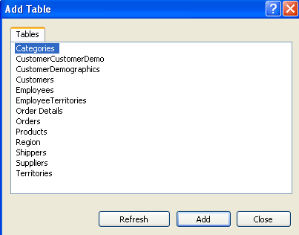
Creating a new diagram cont.
SQL Server starts us out with the Add Table dialog.
Select all the tables
(hold down the
control key or shift
key).
Click ‘Add’.
After SQL Server
has finished creating
the diagram, click
‘Close’.

Slide 34
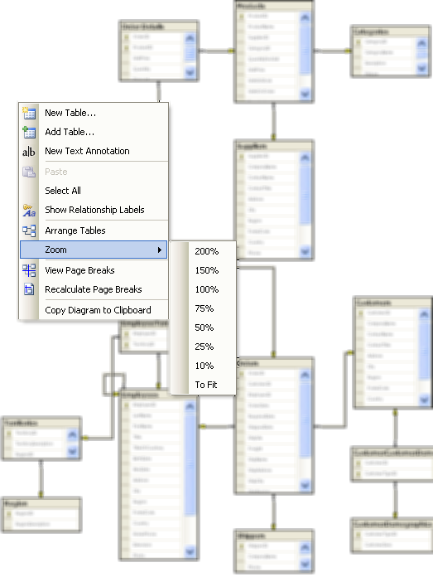
Creating a new diagram cont.
Right click anywhere
within the diagram
window and choose
the zoom level to
see more/less detail.

Slide 35
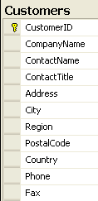
Diagramming Tables
Each table has its own window you can move around.
The primary key is shown with the little symbol of a key in the column to the left of the name like the one
next to the CustomerID:

Slide 36
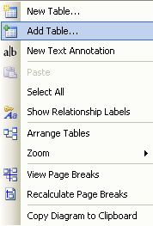
Adding Tables
If you have a table that already exists in the database (but not in the diagram), but now you want to add it to your diagram, you simply click the “add table” button on the diagramming window’s toolbar.

Slide 37
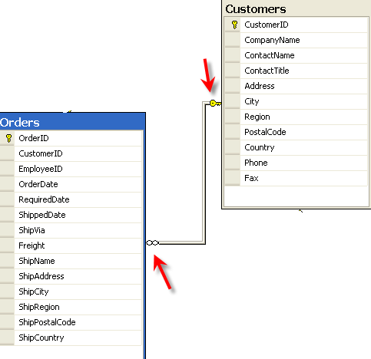
Relationships
Looking at a relationship line, the side with the key is the side that is the “one” side of a relationship.
The side that has the infinity symbol represents your “Many” side.

Slide 38
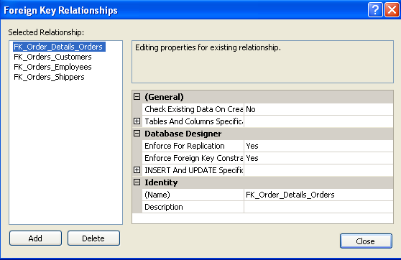
Relationships (cont’d)
Right click the orders table and choose ‘Relationships’ to make edits.

Slide 39
Changing Tables within a Diagram
Changes to tables through the diagramming tool will change the table architecture in the database
Similarly, changes to any tables outside of the diagram will automatically be updated in any saved diagrams

Slide 40
More Database Diagram Concepts
Table operations such as adding indexes, constraints and relationships can be implemented through the database diagram editor in addition to the table designer.
A user’s ability to add/modify database diagrams depends on their permissions in the database. The “owner” of the database or any user who is a member of the db_owner database role can view all of the diagrams.

